Slide 1

PRODUCT SALES FORECAST
SAMEER ANSARI

Slide 2
CONTENT
➢PROBLEM STATEMENT
➢METHODOLOGY
➢INTRODUCTION OF ASSIGNMENT
➢DATA DESCRIPTION
➢EDA
➢FITTING VARIOUS MODEL
➢MODEL PERFORMANCE COMPARISION
➢FORECASTING
➢CONCLUSION

Slide 3
PROBLEM STATEMENT
create an accurate forecast for all products and stores using sales data, including date, store city, product name. The goal is to provide forecasts in hectoliters while ensuring inventory levels remain stable by adding safety stocks. analyze the historical sales data to identify patterns and trends that can be used to predict future sales accurately.

Slide 4
METHODOLOGY
EDA
Model Building
Forecasting
Evaluating

Slide 5
INTRODUCTION
THE BASIC IDEA OF THIS ASSIGNMENT IS TO FORECAST PRODUCT SALES IN FANCY INC . HERE WE HAVE PREVIOUS SALES FROM JAN 2013 TO DEC 2017, INCLUDING THE DATE, STORE CITY, PRODUCT NAME AS OUR MAJOR INFORMATION TO FORECAST. BASED ON THESE FEATURES WE WILL BE FORECASTING SALES FOR JAN 2018. REGRESSION AND TIMES SERIES ARIMA AND SARIMA MODELS WILL BE USED TO DO SO.

Slide 6
DATA DESCRIPTION
Date – Date of sale
Store city – City in which a store is located.
Product Name – Name of the product with quantity marketed.
Sales – Number of units sold

Slide 7
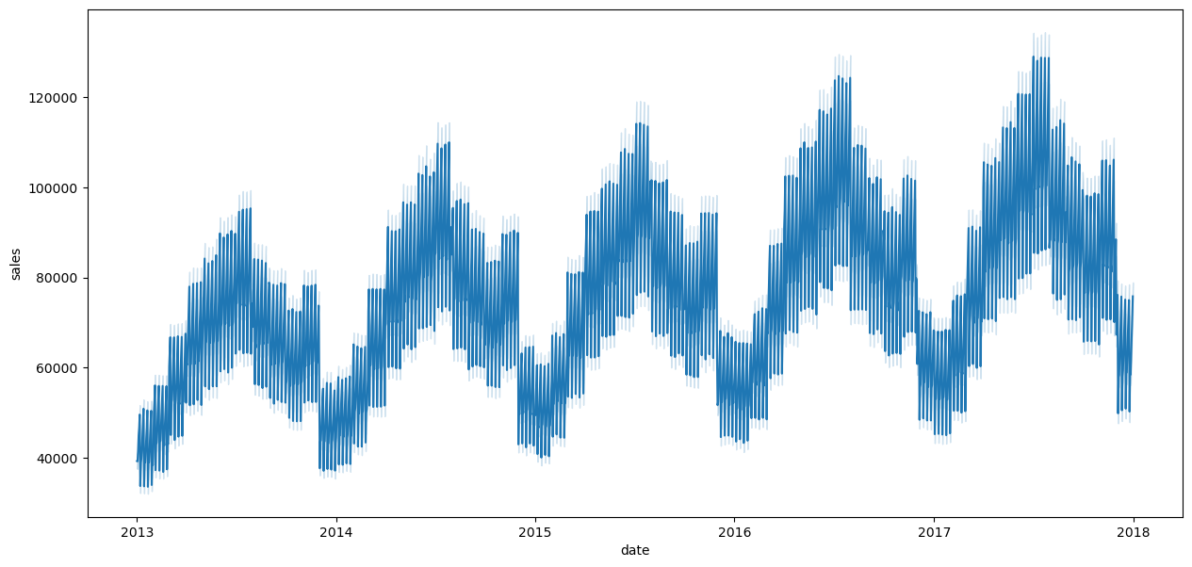
EDA
SALES GROWTH EVERY YEAR

Slide 8
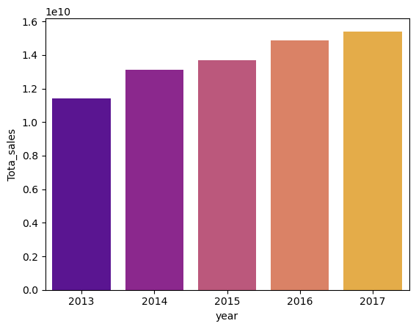
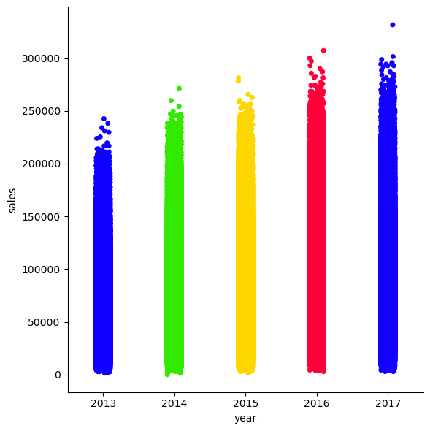
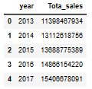
EDA
TOTAL SALES PER YEAR

Slide 9
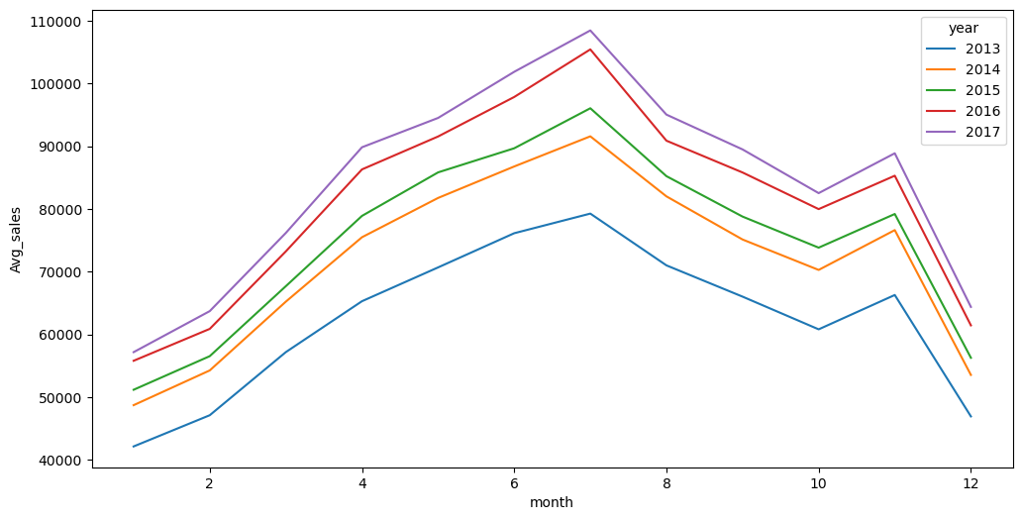
EDA
AVG MONTHLY SALE

Slide 10
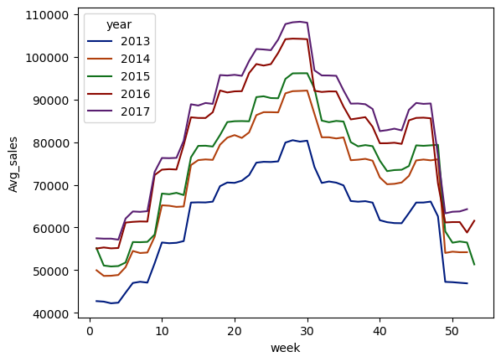
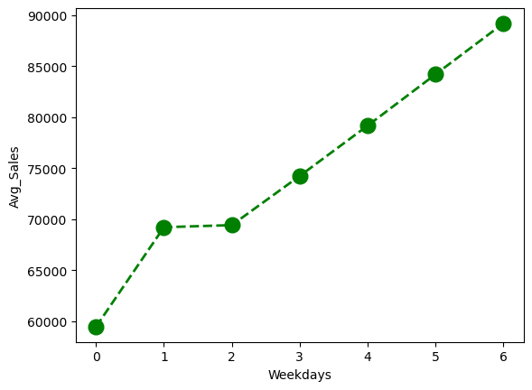
EDA
AVG WEEKLY SALE
AVG DAILY SALE

Slide 11
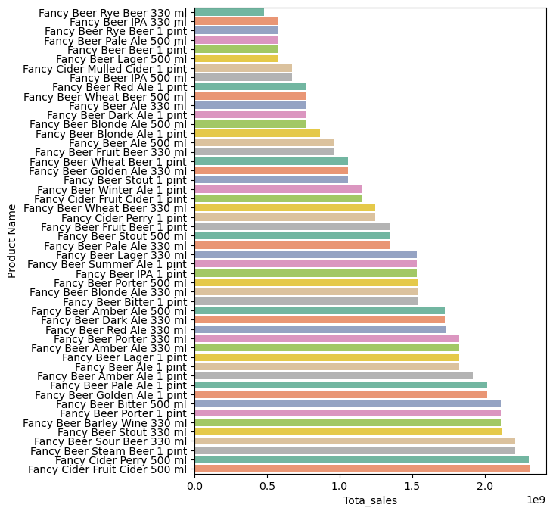
EDA
TOTAL SALES
MADE BY
EACH
PRODUCT

Slide 12
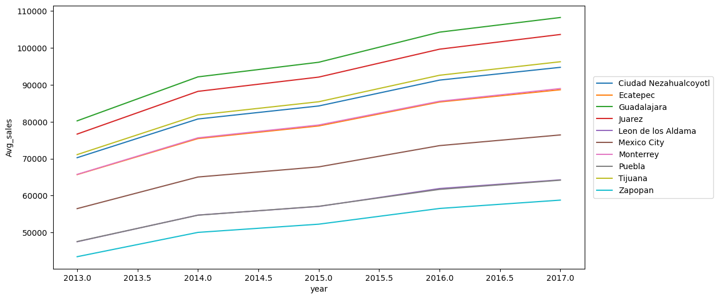
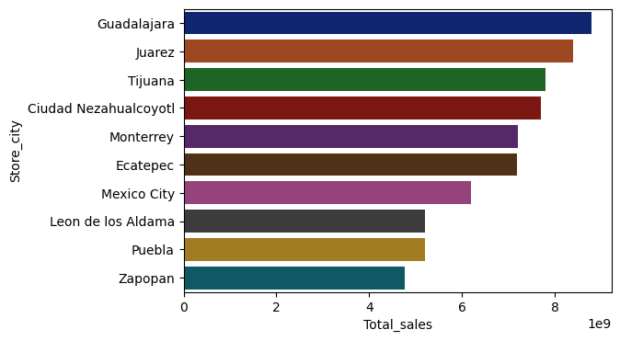
EDA
SALE GROWTH IN CITY YEAR BY YEAR
TOTAL SALES IN EACH CITY

Slide 13
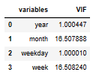
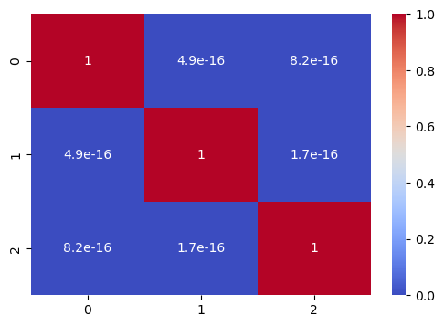

pca
CORRELATION AFTER PCA
BEFORE PCA
AFTER PCA

Slide 14
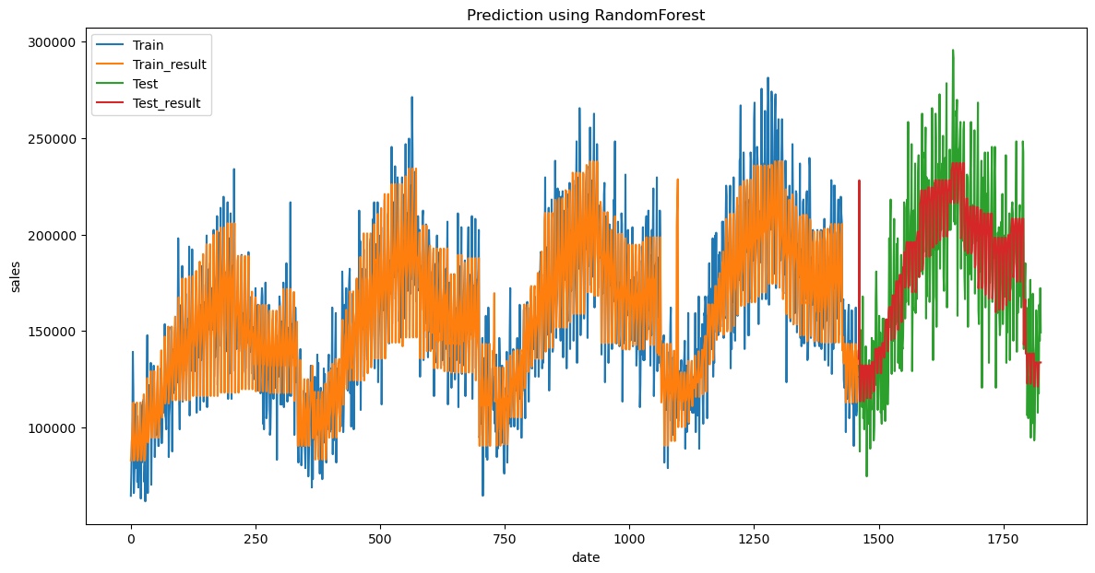
RANDOM FOREST

Slide 15
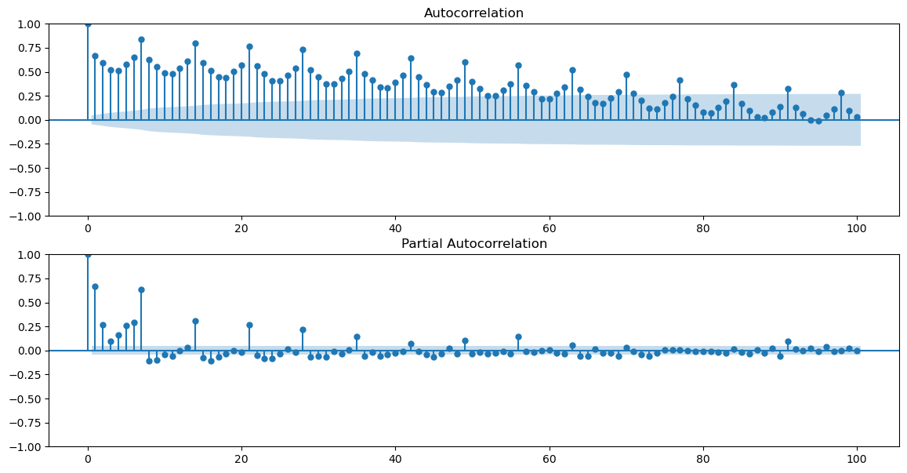
ACF – PCF PLOTS

Slide 16
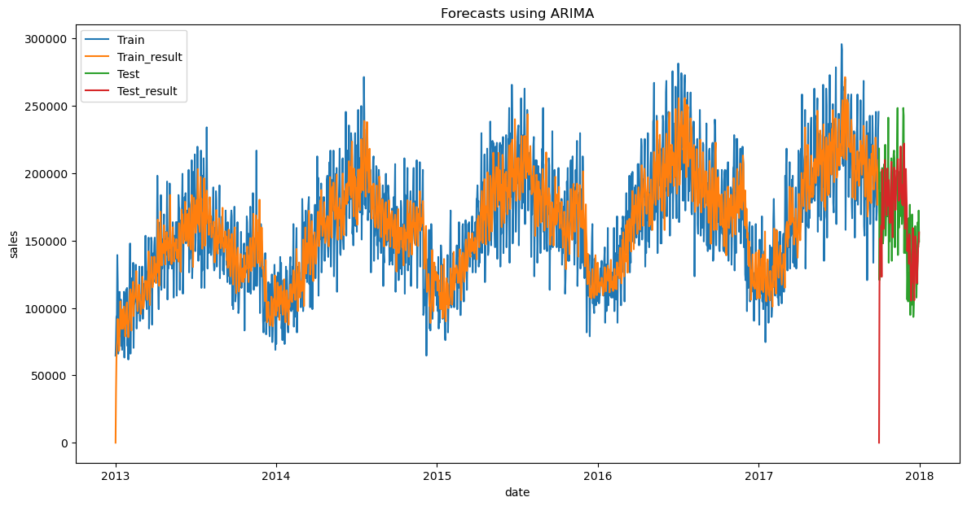
ARIMA MODEL

Slide 17
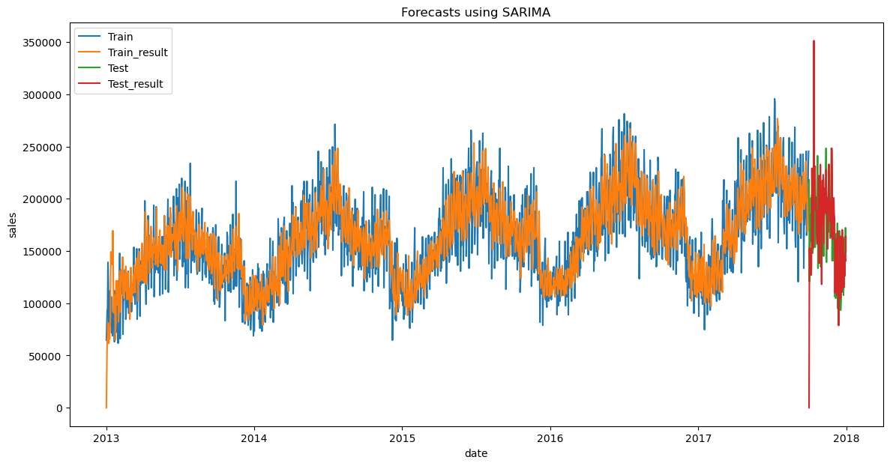
SARIMA MODEL

Slide 18

EVALUATION SCORE

Slide 19
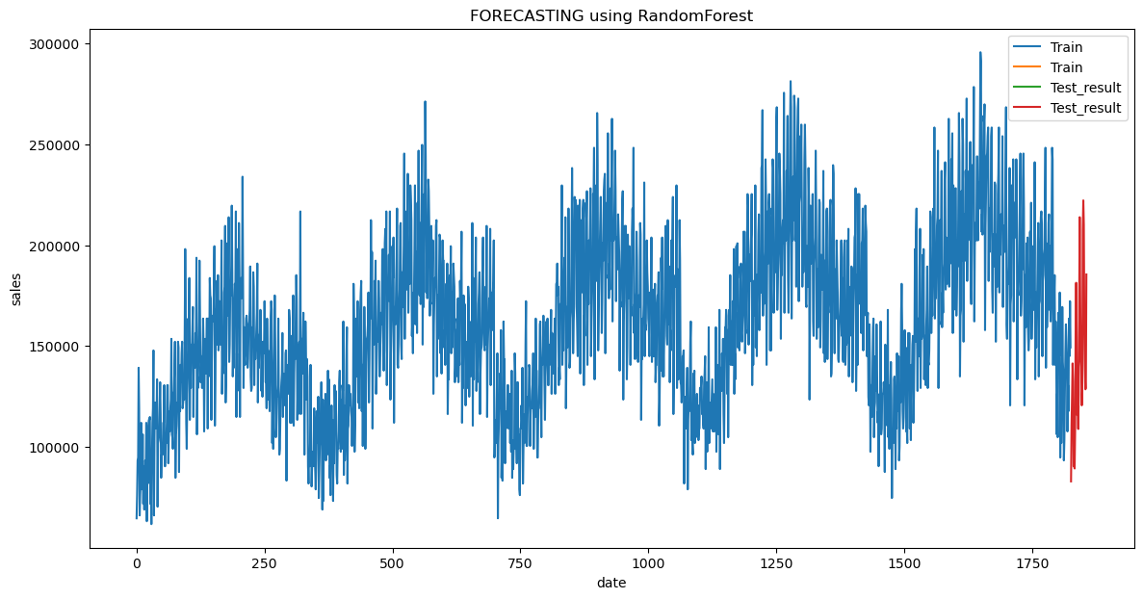
FORECASTING

Slide 20
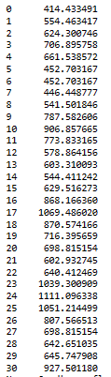
CONCLUSION
FORECAST SALE OF FANCY CIDER PERRY 500 ML FOR GUADALAJARA STORE CITY FOR JAN 2018 IN HECTOLITRES
MAPE of 11% with safety stock of 5%

Slide 21


